Slide 1
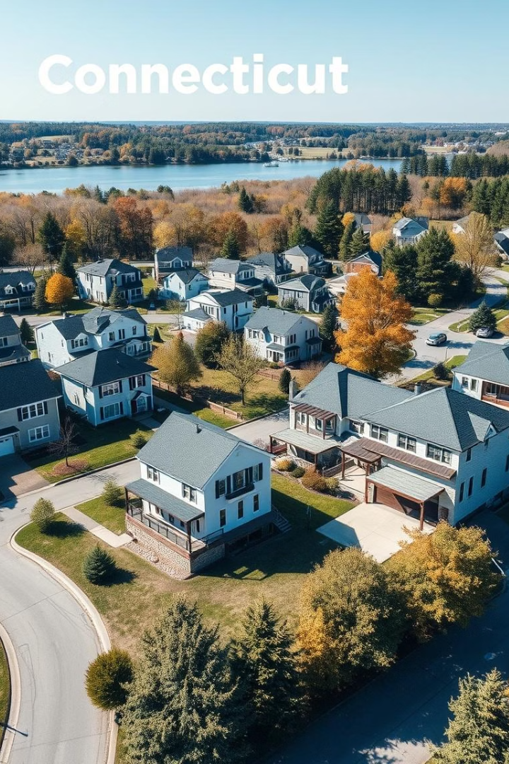
Property Sale Amount Prediction in Connecticut
Group 5 :
Venkata Lakshmi Parimala Pasupuleti - vpasupu2@gmu.edu
Aravind Panchanathan - apanchan@gmu.edu
Sanjay Kumar Podishetty - spodishe@gmu.edu
Dinesh Ponnada - dponnada@gmu.edu
Pramath Rajprasad Rao - prajpras@gmu.edu
Lina Saade - lsaade@gmu.edu
Greeshma Priya Pendyala - gpendya@gmu.edu
Professor: Lam Phung
Course: AIT 582 - 003
Date: May 7, 2025

Slide 2






Introduction
Economic Impact
Real estate sales directly impact economy and individual wealth.
Prediction Benefits
Accurate prediction models improve investment, lending, and planning decisions.
Market Focus
Focus on Connecticut real estate market and education-related factors.
Technology Approach
Machine learning used to predict property sale prices.
Data Integration
Integration of multiple datasets for better prediction quality.
Pyspark and AWS

Slide 3

Problem Statement
Hidden Patterns
Price Dependencies
Traditional valuation methods may not capture hidden patterns.
Sale prices depend on assessed value, local infrastructure, and socio-economic factors.
Model Requirements
Data Challenges
Need for accurate, scalable, and interpretable models.
Challenge: Handling large datasets with missing values and outliers.

Slide 4





Significance
Stakeholder Benefits
Predictive analytics aid real estate investors, banks, and governments.
Policy Optimization
Accurate forecasts help optimize investments and housing policies.
Value Identification
Early identification of undervalued or overvalued properties.
Infrastructure Insights
Insights into role of town infrastructure (schools) on property prices.

Slide 5




Data Overview
Main Property Dataset
Housing Sales Data
Schools Data
Crime Data
Transactions, Assessments.
Sale Amounts.
Number of Schools (PreK–12).
Crime incidents per 100,000 population.
Merged on Town and Year fields.
Preprocessing included missing value treatment and standardization.
List Year
Interval
The year the property was listed for sale.
Date Recorded
Interval
The date of the sale was recorded locally.
Town
Nominal
The name of the town where the property is located.
Address
Nominal
The physical address of the property.
Assessed Value
Ratio
The value of the property used for local tax assessment.
Sale Amount
Ratio
The amount the property was sold for.
Sales Ratio
Ratio
The ratio of the sale price to the assessed value.
Property Type
Nominal
Types of property include Residential, Commercial, Industrial, Apartments, Vacant, etc.
Residential
Nominal
Indicates whether the property is single or multifamily residential
Type
Non-Use Code
Nominal
The sale price is not reliable for use in the determination of a property value
Assessor
Nominal
Additional remarks or notes from the property assessor.
Remarks
OPM remarks
Nominal
Remarks from the Office of Policy and Management (OPM).
Location
Ordinal
Latitude and longitude coordinates of the property.

Slide 6
Literature Review
Impact of Crime Rates: Studies show higher crime rates negatively influence property values by reducing buyer demand and increasing risk perception. (Gibbons, 2004; Ihlanfeldt & Mayock, 2010)
School Quality and Property Prices: Access to high-quality schools is strongly associated with higher home values. Parents often pay a premium to live in better school districts. (Black, 1999; Nguyen-Hoang & Yinger, 2011)
Healthcare Access and Real Estate: Proximity to healthcare facilities improves neighborhood attractiveness and can increase property prices, especially for aging populations. (Beard et al., 2009)
Socioeconomic Indicators: Higher employment rates, average wages, and business density are positively correlated with higher property sale amounts. (Glaeser & Gyourko, 2008)

Slide 7
Research Questions
Which geographic features (e.g., assessed value and sale ratio) most accurately predict property sale prices in Connecticut?
How does access to educational institutions (based on available grade levels) influence residential property values?
What is the impact of assessed value and year of sale on predicting final sale prices of residential properties?

Slide 8
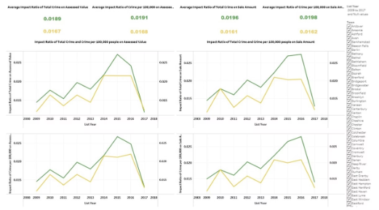
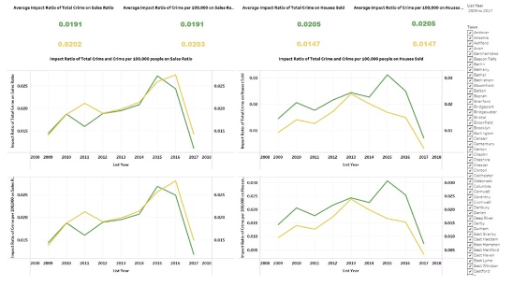
Visualizations
Impact of Crime Rates on Property Sale Amount
Crime Impact on Sales Activity
Crime rates showed moderate influence on Sales Ratio and Houses Sold between 2009–2016.
After 2016, crime impact declined, indicating increasing buyer sensitivity.
Total crime counts had a slightly stronger effect than crime per population.
Crime Impact on Property Values
Higher crime rates correlated with lower Assessed Values and Sale Amounts until 2015.
A sharp drop in crime impact after 2016 suggests market stabilization.
Total crimes influenced property values slightly more than normalized crime rates.

Slide 9
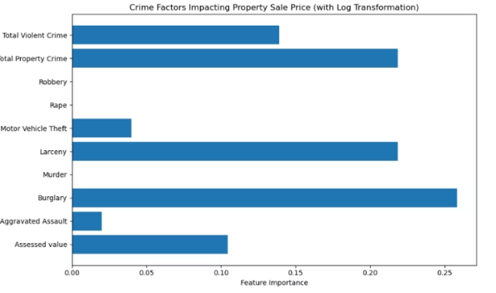
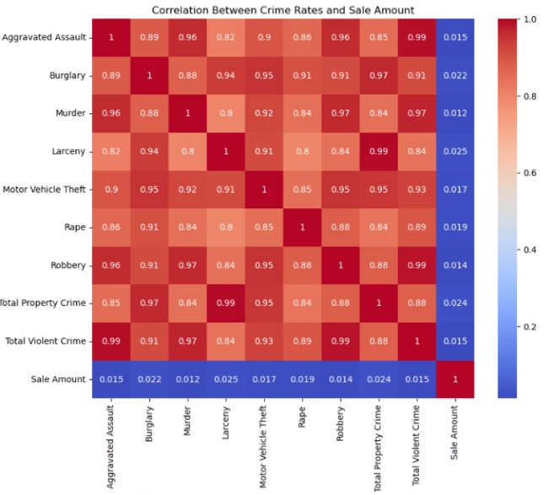
Correlation analysis shows that crime rates have very weak direct relationships with property sale amounts (correlation values around 0.01–0.02).
Feature importance analysis highlights that Burglary, Total Property Crime, and Larceny have a greater influence on property sale prices compared to other crimes.
Key Takeaway: While crime rates individually show weak correlations, certain crimes like Burglary have a more significant indirect impact on housing prices when evaluated through machine learning models.

Slide 10
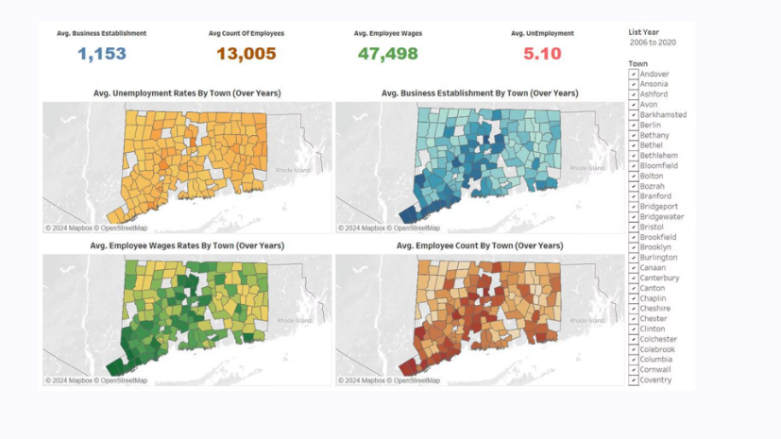
Socioeconomic Factors Across Connecticut Towns
Unemployment Rates:
Business Establishments:
Employee Wages:
Employee Counts:
Higher unemployment observed in northern and interior regions, possibly reducing property demand.
Higher concentration of businesses near coastal areas and major cities, boosting local economies.
Western and southern Connecticut show higher average wages, correlating with higher property values.
Densely populated urban areas exhibit larger employee counts, supporting stronger housing markets.

Slide 11
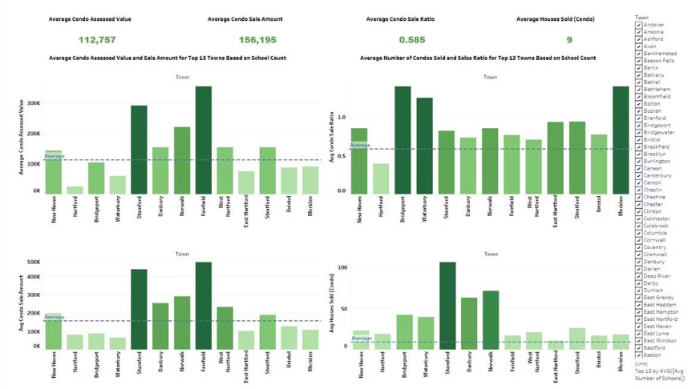
Condo Sales Analysis Based on School Availability
Higher Assessed and Sale Values
Condo Sale Ratio Trends
Towns like Fairfield and Stamford report significantly higher condo assessed values and sale prices.
Bridgeport and Waterbury show the highest condo sale ratios, indicating strong buyer demand relative to assessed values.
Units Sold Distribution
School Count Correlation
Stamford leads in the number of condos sold, reflecting a highly active condo market.
Towns with a greater number of schools tend to have more vibrant and higher-value condo markets.

Slide 12

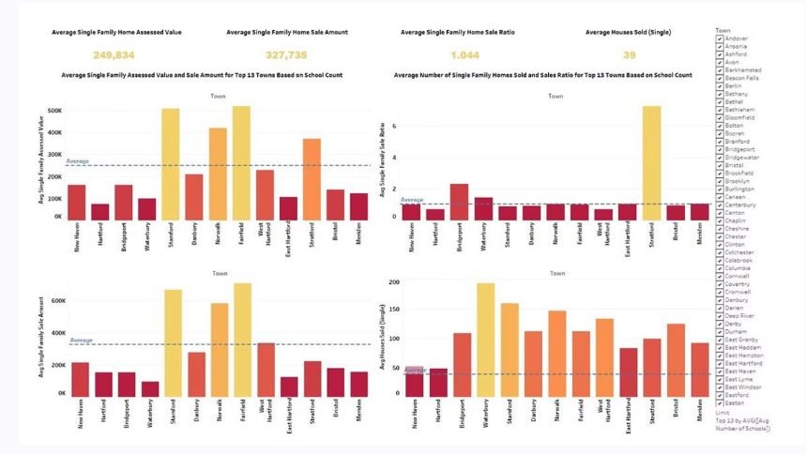
Single-Family Home Sale Analysis Based on School Availability
Higher Valuations: Stamford and Fairfield show the highest assessed and sale values for single-family homes among all towns.
Sale Ratios Vary: Towns like Stratford and Waterbury show higher sale ratios, indicating homes are selling above or close to assessed value.
Units Sold Distribution: Waterbury and Stamford recorded the highest number of single-family home sales.
School Presence Influence: Towns with more schools generally have better sales performance and higher average prices, supporting the role of educational infrastructure in boosting real estate markets.

Slide 13
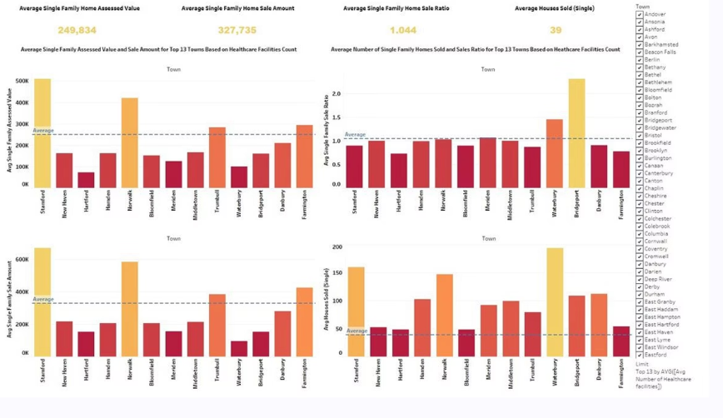
Impact of Healthcare Facilities on Property Sales
Healthcare Facilities Impact
Strong Values in Stamford and Bloomfield
Towns with more healthcare facilities generally had higher assessed values and sale amounts for single-family homes.
Stamford and Bloomfield showed particularly strong property values linked with better healthcare access.
Higher Sale Ratios
Positive Influence of Healthcare
Towns with higher healthcare facility counts also recorded higher houses sold and sale ratios compared to others.
Suggests that proximity to healthcare positively influences real estate demand and property prices.

Slide 14
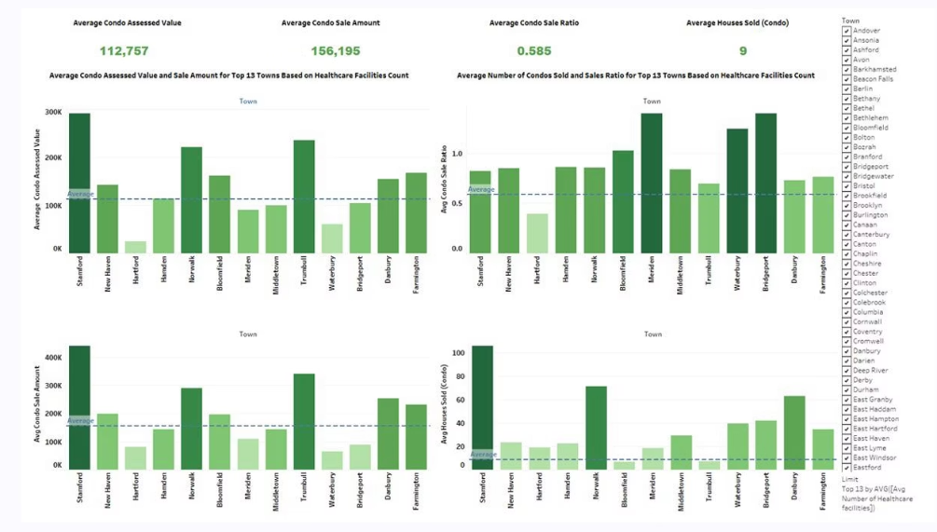
Impact of Healthcare Facilities on Condo Sales
1
Condo Values Soar in Healthcare Hubs
2
Brisk Condo Sales in Healthy Towns
Towns like Stamford and Bloomfield, with abundant healthcare facilities, see sky-high condo assessed values and sale prices.
Condo sales ratios and the number of units sold are significantly higher in areas with greater healthcare access.
3
Healthcare Fuels Condo Demand
The presence of robust healthcare infrastructure appears to drive strong real estate activity and property values for condos.
4
Healthcare Matters for Condo Buyers
Convenient access to healthcare is an important
socioeconomic factor that shapes condo market trends.

Slide 15
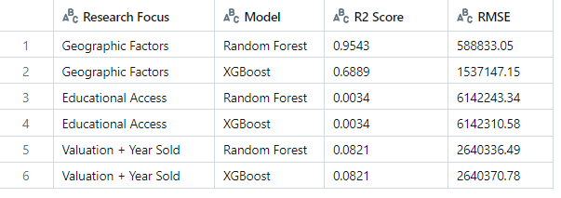
Modeling Approach
Model Selection
Used Random Forest Regressor and XGBoost Regressor.
Target Variable
Target variable: Sale Amount.
Feature Selection
Features: Assessed Value, Sale Ratio, Number of Schools.
Data Split
Train/Test split: 80% for training, 20% for testing.
Evaluation Metrics
Evaluation metrics: R² Score and RMSE.
Model
R² Score
RMSE
Random Forest
0.9469
$499,925.10
XGBoost
0.3788
$1,710,477.60

Slide 16
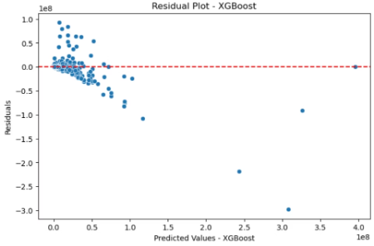
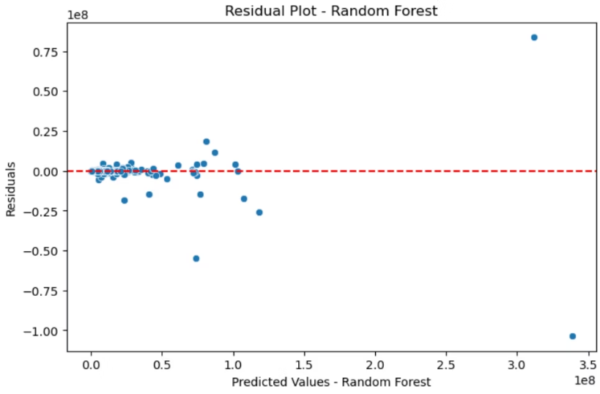
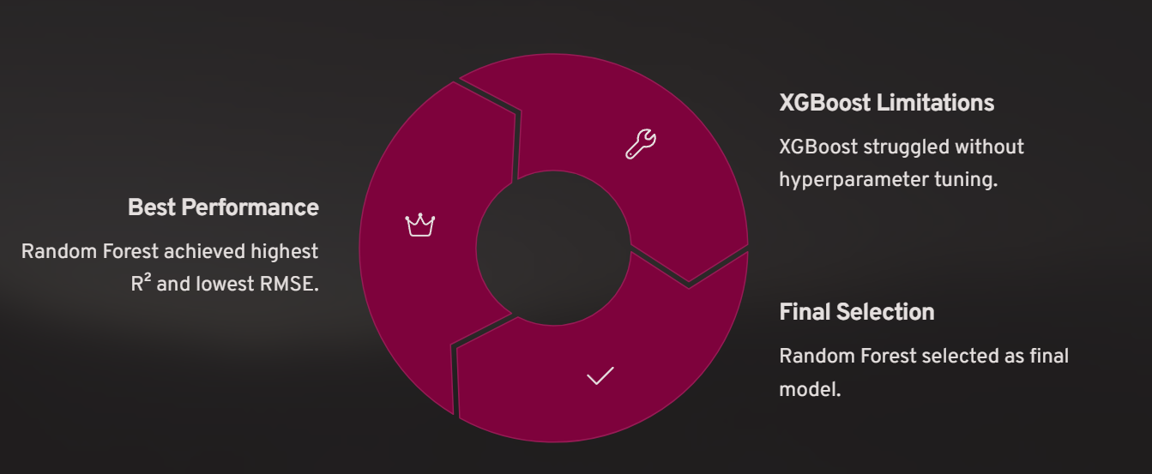
Model Result
Final Selection
Random Forest selected as final model.

Slide 17
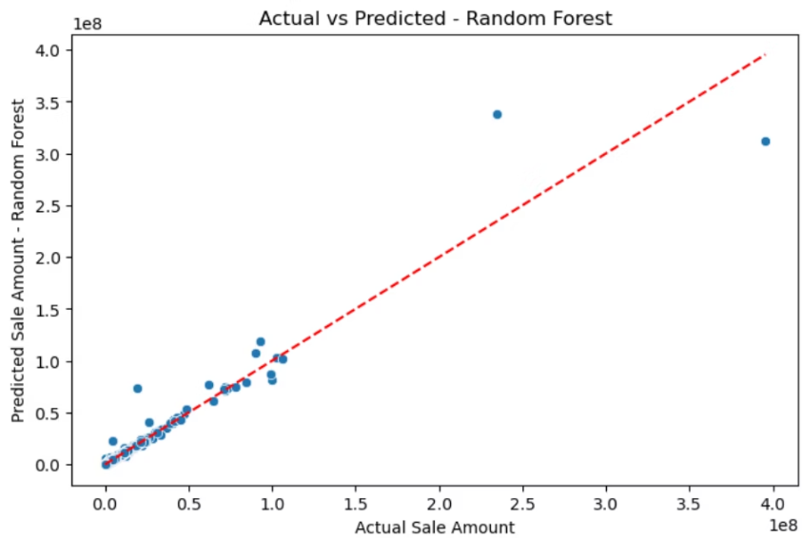
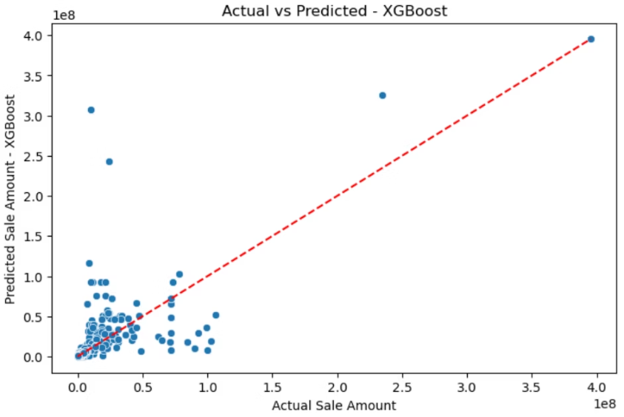
Predicted Analysis
Random Forest
XGBoost
Residuals tightly clustered around zero. Predictions closely matched actual sale prices.
Residuals widely scattered, indicating poor fit. Predictions showed significant underestimation.

Slide 18
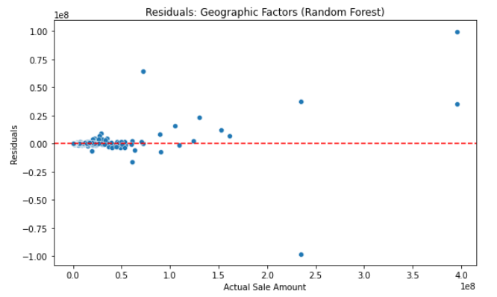
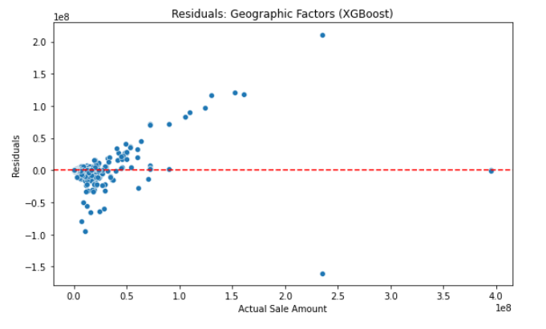
Geographic Factors
Research Question 1: Which geographic features (e.g., assessed value and sale ratio) most accurately predict property sale prices in Connecticut?
Models Used: Random Forest, XGBoost
Best Performing Model: Random Forest
Key Results:
R² = 0.9543
RMSE ≈ $588,833
Insight:
Assessed value and sale ratio are highly predictive.
Geographic valuation explains most of the variability in sale price.

Slide 19
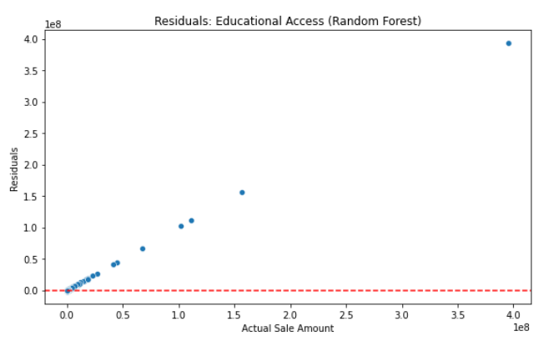
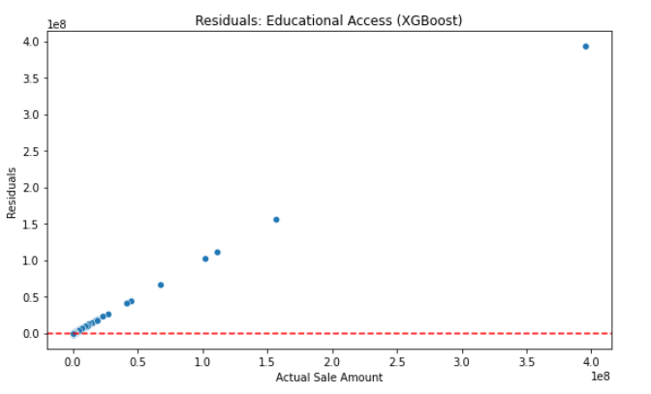
Educational Access
Research Question 2: How does access to educational institutions (based on available grade levels) influence residential property values?
Models Used: Random Forest, XGBoost
Results for Both Models:
R² = 0.0034
RMSE ≈ $6.14 million
Insight:
School grade count alone (PreK–12) does not significantly affect sale price.
May need to consider quality ratings or proximity in future studies.

Slide 20
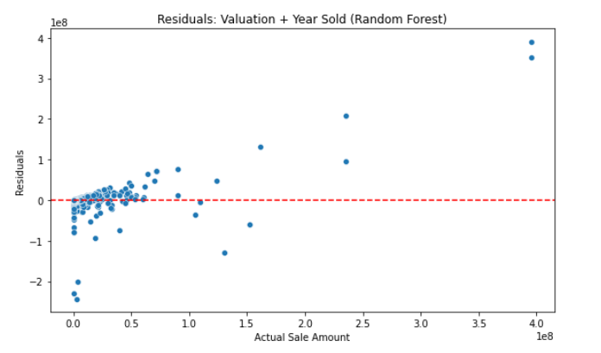
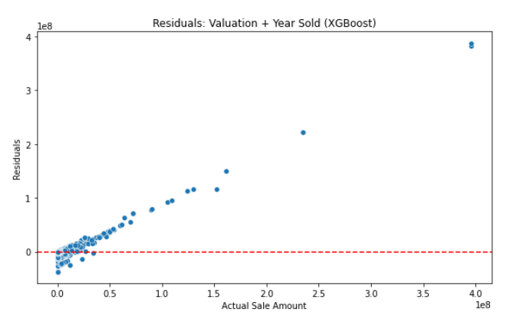
Valuation + Year Sold
Research Question 3: What is the impact of assessed value and year of sale on predicting final sale prices of residential properties?
Models Used: Random Forest, XGBoost
Key Results:
R² = 0.0821
RMSE ≈ $2.64 million
Insight:
Year of sale adds minimal improvement over assessed value alone.
Indicates housing value trends are mostly static or already captured.

Slide 21
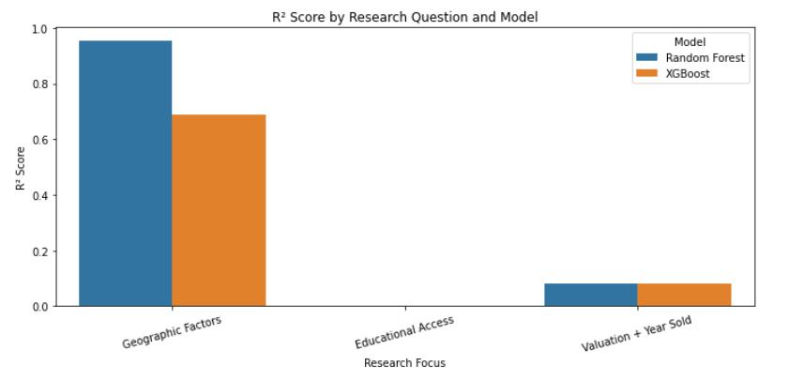
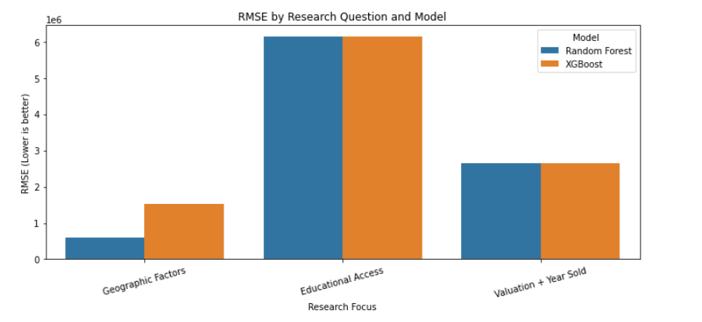
Model performance comparision

Slide 22
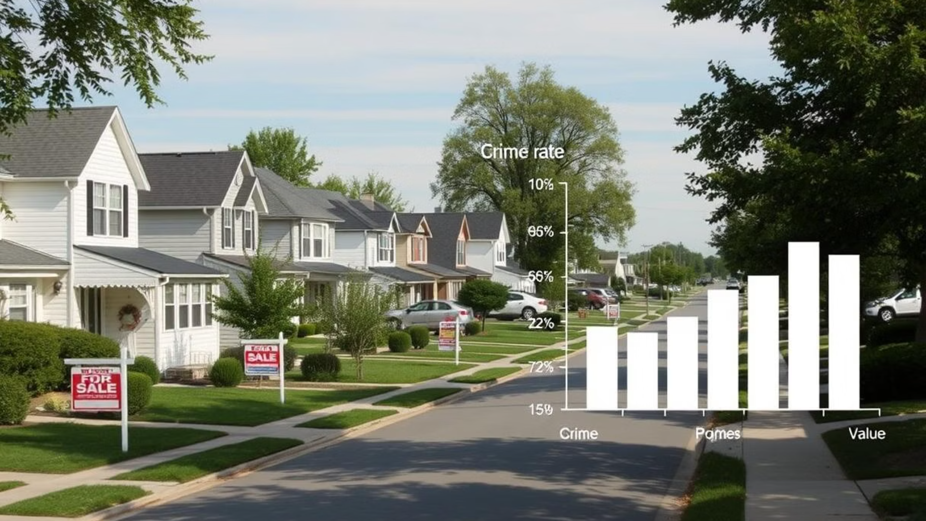
Conclusion
Key Findings
Summary
Thriving Towns, Thriving Homes
Towns with low crime rates and strong school infrastructure saw the highest property sale prices. Higher crime rates were linked to lower property values, confirming a troubling trend. Violent crimes had a stronger negative impact on prices compared to property crimes. Assessed value, school availability, and low crime rates together drove higher sale prices. The findings validated the hypotheses and highlighted the power of data integration for accurate property valuation.
Crime's Costly Toll
Violent Crimes, Volatile Values
The Winning Formula
Validation and Insights

Slide 23





Conclusion
Integrate Broader Datasets
Encompass economic indicators, demographic shifts, and housing market trends.
Investigate Machine Learning
Explore ensemble stacking and deep learning methodologies.
Enhance Data Quality
Implement refined outlier detection and removal strategies.
Boost Predictive Accuracy
Develop targeted feature engineering approaches for better model interpretability.
Forecast Future Trajectories
Expand analysis to predict future property value trends using time series analysis.

Slide 24


Slide 25

Thank you
Thank you for your time and attention! We hope this presentation provided valuable insights into property sale amount prediction in Connecticut.

